Slide 1
Social Media Post & Caption Generator
Generate catchy captions, relevant hashtags, and emojis for social media posts (e.g., Instagram, LinkedIn, Twitter) based on user-provided keywords or themes.

Slide 2
Why Social Media Post & Caption Generator ?
A Social Media Post & Caption Generator offers a quick and efficient way to create engaging, audience-specific captions, saving users time and creative effort. It helps maintain consistency in tone—whether professional, funny, or inspirational—and boosts content quality, leading to better engagement across platforms. This tool is especially useful for influencers, marketers, and small businesses who post frequently and need fresh, relevant content ideas. With its customizable features and potential for AI integration, it also serves as a strong, scalable project for developers looking to build practical, portfolio-worthy applications.

Slide 3
Key Features
Post Type Selection
Keyword-Based Suggestions
Caption Length Options
Instant Caption Generator
Suggested Hashtags (for Long Captions)

Slide 4
LANGUAGES USED
HTML - Contains only the structure and markup, with links to external CSS and JavaScript files.
CSS - Contains all styling including:
Font imports
CSS variables
Component styles
Responsive design
Animations and transitions

Slide 5
JAVA SCRIPT
Contains all functionality including:
Caption database
Event handlers
Caption generation logic
Hashtag generation
Performance optimizations

Slide 6
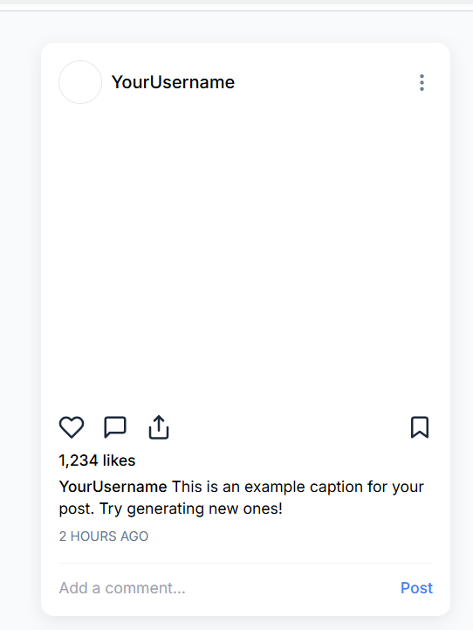
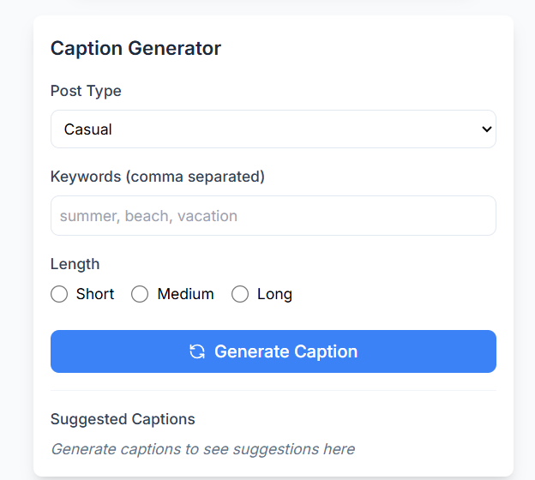
Demo Model

Slide 7
Thank you

